Slide 1
Data Structure & Algorithms
Interval Trees

Slide 2

Interval trees
Goal: To maintain a dynamic set of intervals, such as time intervals.
i = [7, 10]
low[i] = 7
5
4
10 = high[i]
11
15
17
19
18 22 23
8
Query: For a given query interval i, find an interval in the set that overlaps i.

Slide 3
Following the methodology
Choose an underlying data structure.
Red-black tree keyed on low (left) endpoint.
Determine additional information to be stored in the data structure.
Store in each node x the largest value m[x] in the subtree rooted at x, as well as the interval int[x] corresponding to the key.
int
m

Slide 4
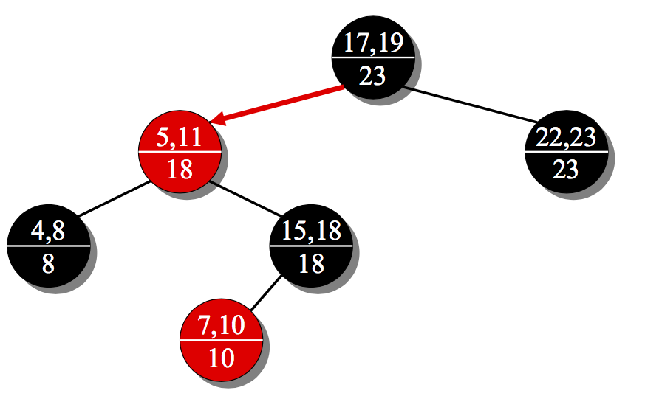
Example interval tree
high[int[x]]
m[left[x]]
m[right[x]]
m[x] = max

Slide 5
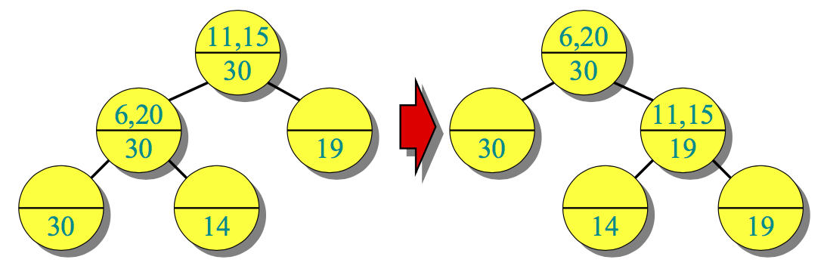
Modifying operations
Verify that this information can be maintained for modifying operations.
INSERT: Fix m’s on the way down.
Rotations — Fixup = O(1) time per rotation:
Total INSERT time = O(lg n); DELETE similar.

Slide 6
New operations
4. Develop new dynamic-set operations that use the information.
INTERVAL-SEARCH(i)
x ← root
while x ≠ NULL and (low[i] > high[int[x] or low[int[x]] > high[i])
do i and int[x] don’t overlap
if left[x] ≠ NULL and low[i] ≤ m[left[x]]
then x ← left[x]
else x ← right[x]
return x

Slide 7
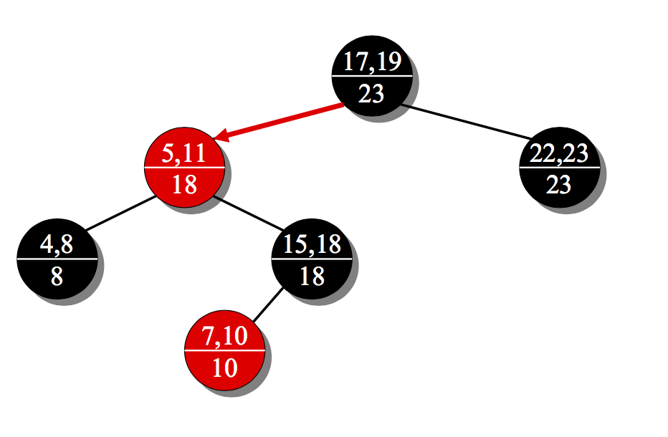
Example 1: INTERVAL-SEARCH([14,16])
x
x ← root
[14,16] and [17,19] don’t overlap
14 ≤ 18 ⇒ x ← left[x]

Slide 8
Example 1: INTERVAL-SEARCH([14,16])
x
[14,16] and [5,11] don’t overlap
14 > 8 ⇒ x ← right[x]

Slide 9
Example 1: INTERVAL-SEARCH([14,16])
x
[14,16] and [15,18] overlap
return [15,18]

Slide 10
Example 2:INTERVAL-SEARCH([12,14])
x
x ← root
[12,14] and [17,19] don’t overlap
12 ≤ 18 ⇒ x ← left[x]

Slide 11
Example 2:INTERVAL-SEARCH([12,14])
x
[12,14] and [5,11] don’t overlap
12 > 8 ⇒ x ← right[x]

Slide 12
Example 2:INTERVAL-SEARCH([12,14])
x
[12,14] and [15,18] don’t overlap
12 > 10 ⇒ x ← right[x]

Slide 13
Analysis
Time = O(h) = O(lg n), since INTERVAL-SEARCH does constant work at each level
as it follows a simple path down the tree.
List all overlapping intervals:
Search, list, delete, repeat.
Insert them all again at the end.
Time = O(k lg n), where k is the total number of overlapping intervals.

Slide 14
Correctness
Theorem. Let L be the set of intervals in the left subtree of node x, and let R be the set of intervals in x’s right subtree.
If the search goes right, then { i ′ ∈ L : i ′ overlaps i } = ∅.
If the search goes left, then {i ′ ∈ L : i ′ overlaps i } = ∅ ◊ {i ′ ∈ R : i ′ overlaps i } = ∅
In other words, it’s always safe to take only 1 of the 2 children: we’ll either find something, or nothing was to be found.

Slide 15
Correctness proof
Proof. Suppose first that the search goes right.
If left[x] = NULL, then we’re done, since L = ∅.
Otherwise, the code dictates that we must have low[i] > m[left[x]]. The value m[left[x]] corresponds to the high endpoint of some interval j ∈ L, and no other interval in L can have a larger high endpoint than high[ j].
i
low(i)
j
L
high[ j] = m[left[x]]
Therefore, {i ′ ∈ L : i ′ overlaps i } = ∅.

Slide 16
Proof (continued)
Suppose that the search goes left, and assume that
{i ′ ∈ L : i ′ overlaps i } = ∅.
Then, the code dictates that low[i] ≤ m[left[x]] = high[ j] for some j ∈ L.
Since j ∈ L, it does not overlap i, and hence high[i] < low[ j].
But, the binary-search-tree property implies that for all i ′ ∈ R, we have low[ j] ≤ low[i ′].
But then {i ′ ∈ R : i ′ overlaps i } = ∅.
i
j
i ′
L

